Slide 1
Vehicle to x communication
Pawan Chandra

Slide 2
AGENDA
Introduction
Problem
My Solution
Methodology
Limitations
Conclusion

Slide 3
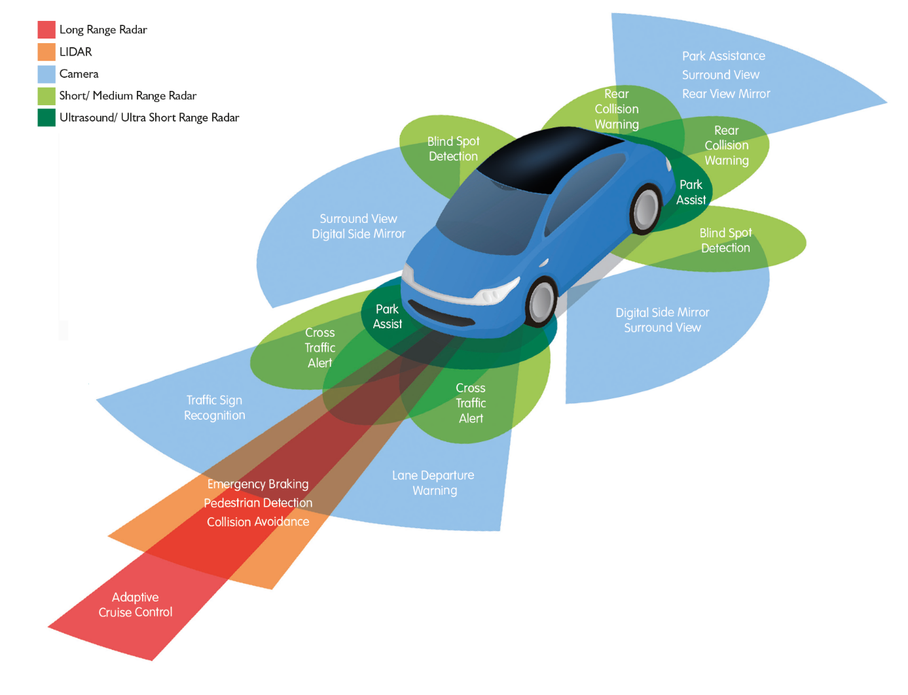
Autonomous vehicles
DEF: Automobiles that uses driver assistance technologies to remove the need for a human operator.
Pros
Eliminate traffic congestion
Reduce accidents
Cut travel cost
Environmental Degradation
Etc.
Notes:
Autonomous vehicles are the Present and the Future of this world
Image (ADAS – Advanced Driver Assistant System)

Slide 4
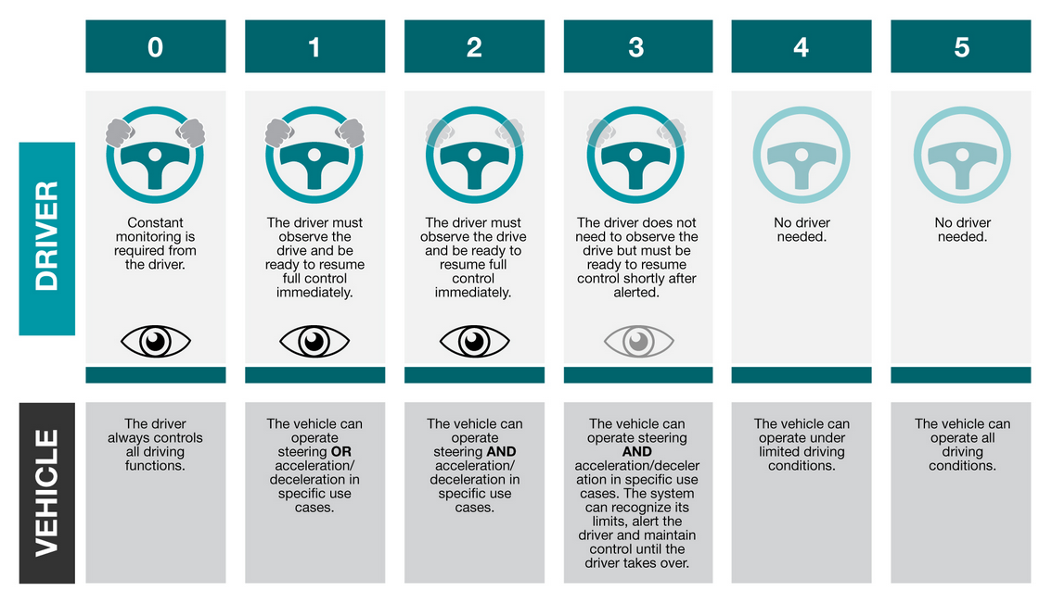
Notes:
Level 0 uses no technology, and that the driver is responsible of all the monitoring and controlling of the vehicle.
Level 1 This is the lowest level of autonomous vehicle. These types of cars has radar cruise control or lane side assistance
Level 2 is pretty much what tesla’s offer in their autopilot feature. The cars that are level 2 can steer while accelerating or decelerating
Level 3 Mercedes was the first company to get approved this year for production and sale in the united states. Though internationally Honda was the first to get approved. Level 3’s can identify stop signs, hazards, and make decisions based on that
Level 4 is sometimes called eyes off because you can literally be in the car without a driver. Waymo Uber Lyft Google, these companies already released self driving Taxis this year in some cities
Level 4’s are limited in certain location due to road conditions. Level 5 means it can drive anywhere and be able to handle all conditions

Slide 5
Area of Focus
Level 1
ADAS
Some Sensors
Level 2
ADAS
Advance Sensors
High Detailed Mapping
Computer Processor
Level 3
ADAS
Advance Sensors
High Detailed Mapping
Communication (V2X)
Artificial Intelligence
Redundant System
Level 4 – 5
ADAS
More Advance Sensors
High Detailed Mapping
Communication (V2X)
Advance Artificial Intelligence
Redundant System
Advance deep learning
More
Notes:
The technology that goes into these autonomous vehicles. Remember the V2X on level 3 as this will be important later

Slide 6
AGENDA
Introduction
Problem
My Solution
Methodology
Limitations
Conclusion

Slide 7
the cars already on the road
No Government Incentives
Cost to upgrade
Sensors
Compromise Geometry
New Car
Slows down the AI Future
Notes:
With car manufactures planning to release level 3 autonomous vehicles to the public soon, there are currently no government incentives planned for people to trade in their vehicles or provide financial support.

Slide 8
AGENDA
Introduction
Problem
My Solution
Methodology
Limitations
Conclusion

Slide 9
My solution & project
Implement and integrate a Vehicle to X (V2X) Communication device on levels 0-2.
Will not make car autonomous:
Server
GUI
Waze
Notes:
The X stands for everything. A V2X is a communication between vehicles to vehicles, vehicle to infrastructure, vehicles to mobile devices and more.
This will not make cars autonomous at all. Levels 3 and above use a lot of sensors, artificial intelligence, and data processing to make decisions. What my solution/project is to implement a device that can use that same data from the smart cars around and relay that information to all the level 2 and below vehicles.

Slide 10
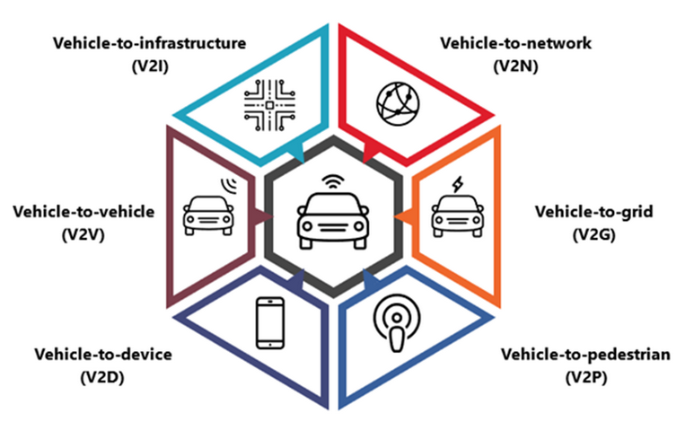
Notes:
Here are types of Vehicle communications

Slide 11
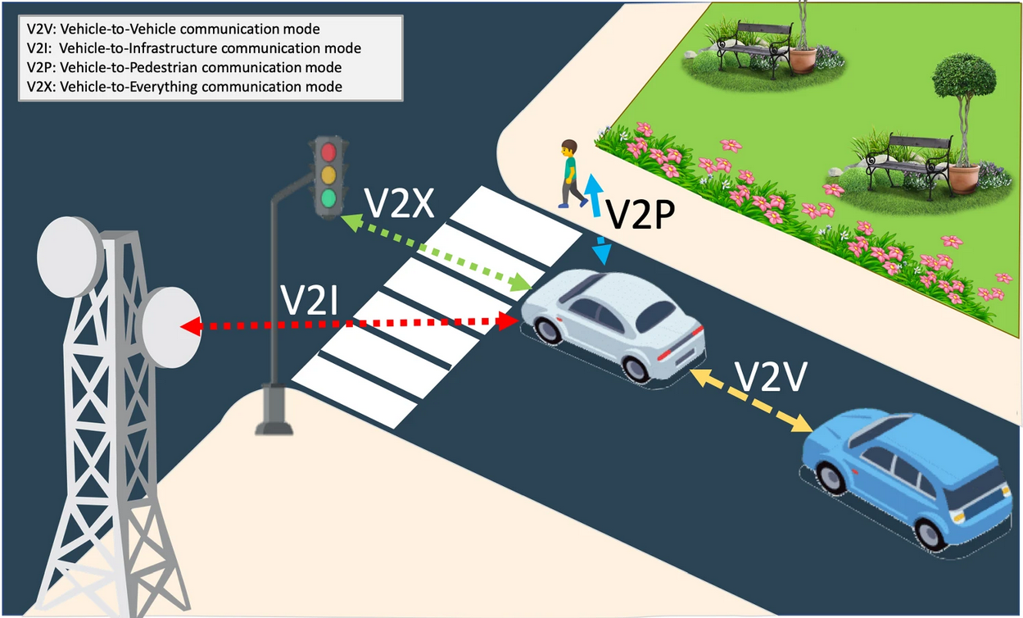
Notes:
Pretend the white care is a level 3 or above autonomous vehicle and the blue car is your average level 0 corolla. By having a V2X device that allows you to communicate with the car ahead, the blue car now has information on what color the traffic light is and that there is a pedestrian about to cross

Slide 12
AGENDA
Introduction
Problem
My Solution
Methodology
Limitations
Conclusion

Slide 13
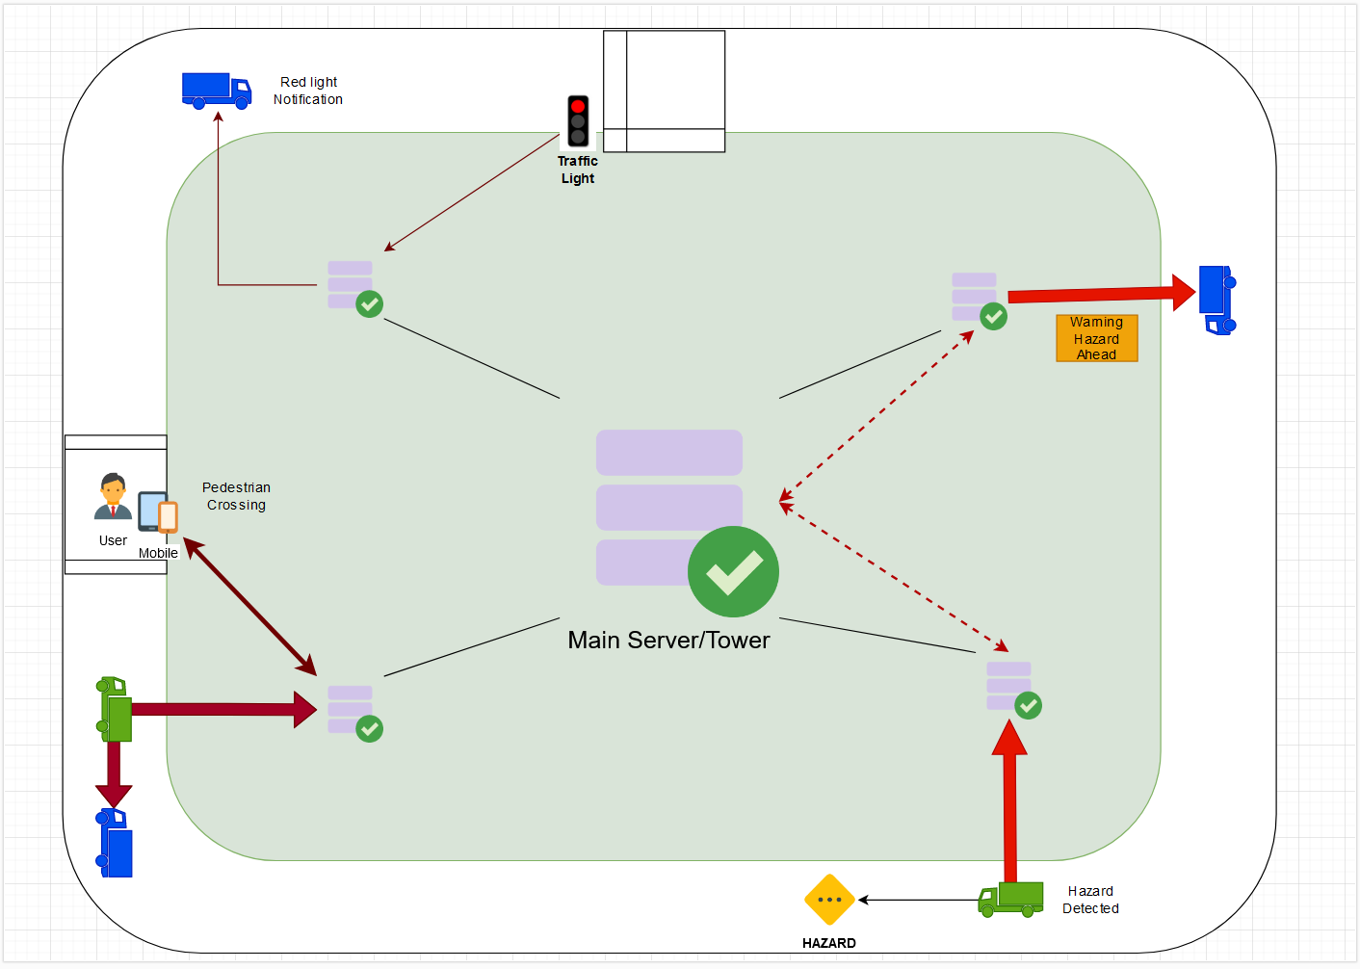
3 Testing Conditions
Step 1
Create 2 cars
Level 3
Level 0
Step 2
Create multiple servers
On the car
Traffic Light
(DS) Cell Phones
Step 3
Collect and pass data from servers
Step 4
Create Test Environment and Test

Slide 14
RESULT
DEMO CAR and CODE
Microcontroller
Camera and AI
Network
Master Slave configuration
Arduino Code
Walkthrough of vehicle
C++ with OpenCV2
Road
Object Detection
RaspiCam
Vector Programming
Python Script
- TCP Client Server Comms
Notes:
Arduino Uno

Slide 15
AGENDA
Introduction
Problem
My Solution
Methodology
Limitations
Conclusion

Slide 16
Limitations
LOCATION
Radio Frequency
PROCESSOR
Overheating
FUNDING
Raspberry Market
Embedded Systems
KNOWLEDGE
Triangulation
Memory Capacity
Soldering Tools
Microcontrollers
Soldering
Fabrication
32-bits

Slide 17
AGENDA
Introduction
Problem
My Solution
Methodology
Limitations
Conclusion

Slide 18
Future work
Optical Encoders
Triangulation
Upgrading raspberry pi
Using python

Slide 19
TIMELINE
September
Building the vehicles and setting up servers ~ 143 hours
October
Cont. building vehicles and began programming ~ 95 hours
November
Programming AI and testing vehicle on environment ~ 76 hours
(STUCK)
December
Paper and Demo

Slide 20
THANK YOU
Pawan Chandra
pchandra@csu.fullerton.edu
Notes:
I work full time and am taking 3 classes including this one and knowing what I know now, I this project would be a perfect candidate for a year long maybe 2 year long masters project.

